Slide 1

A
Technical seminar on Applications of cloud computing for power systems
by
S.OBUL NAIDU(18705A0217)
IV B.TECH II SEM
Under the esteemed guidance of
Mr. C.GANESH, M.Tech.
Assistant Professor
DEPARTMENT OF ELECTRICAL & ELECTRONICS ENGINEERING
ANNAMACHARYA INSTITUTE OF TECHNOLOGY AND SCIENCES
( AUTONOMOUS ) AFFILIATED TO J.N.T.U ANANTHAPURAM. RAJAMPET-516126 ( A.P ) 2020-2021

Slide 2
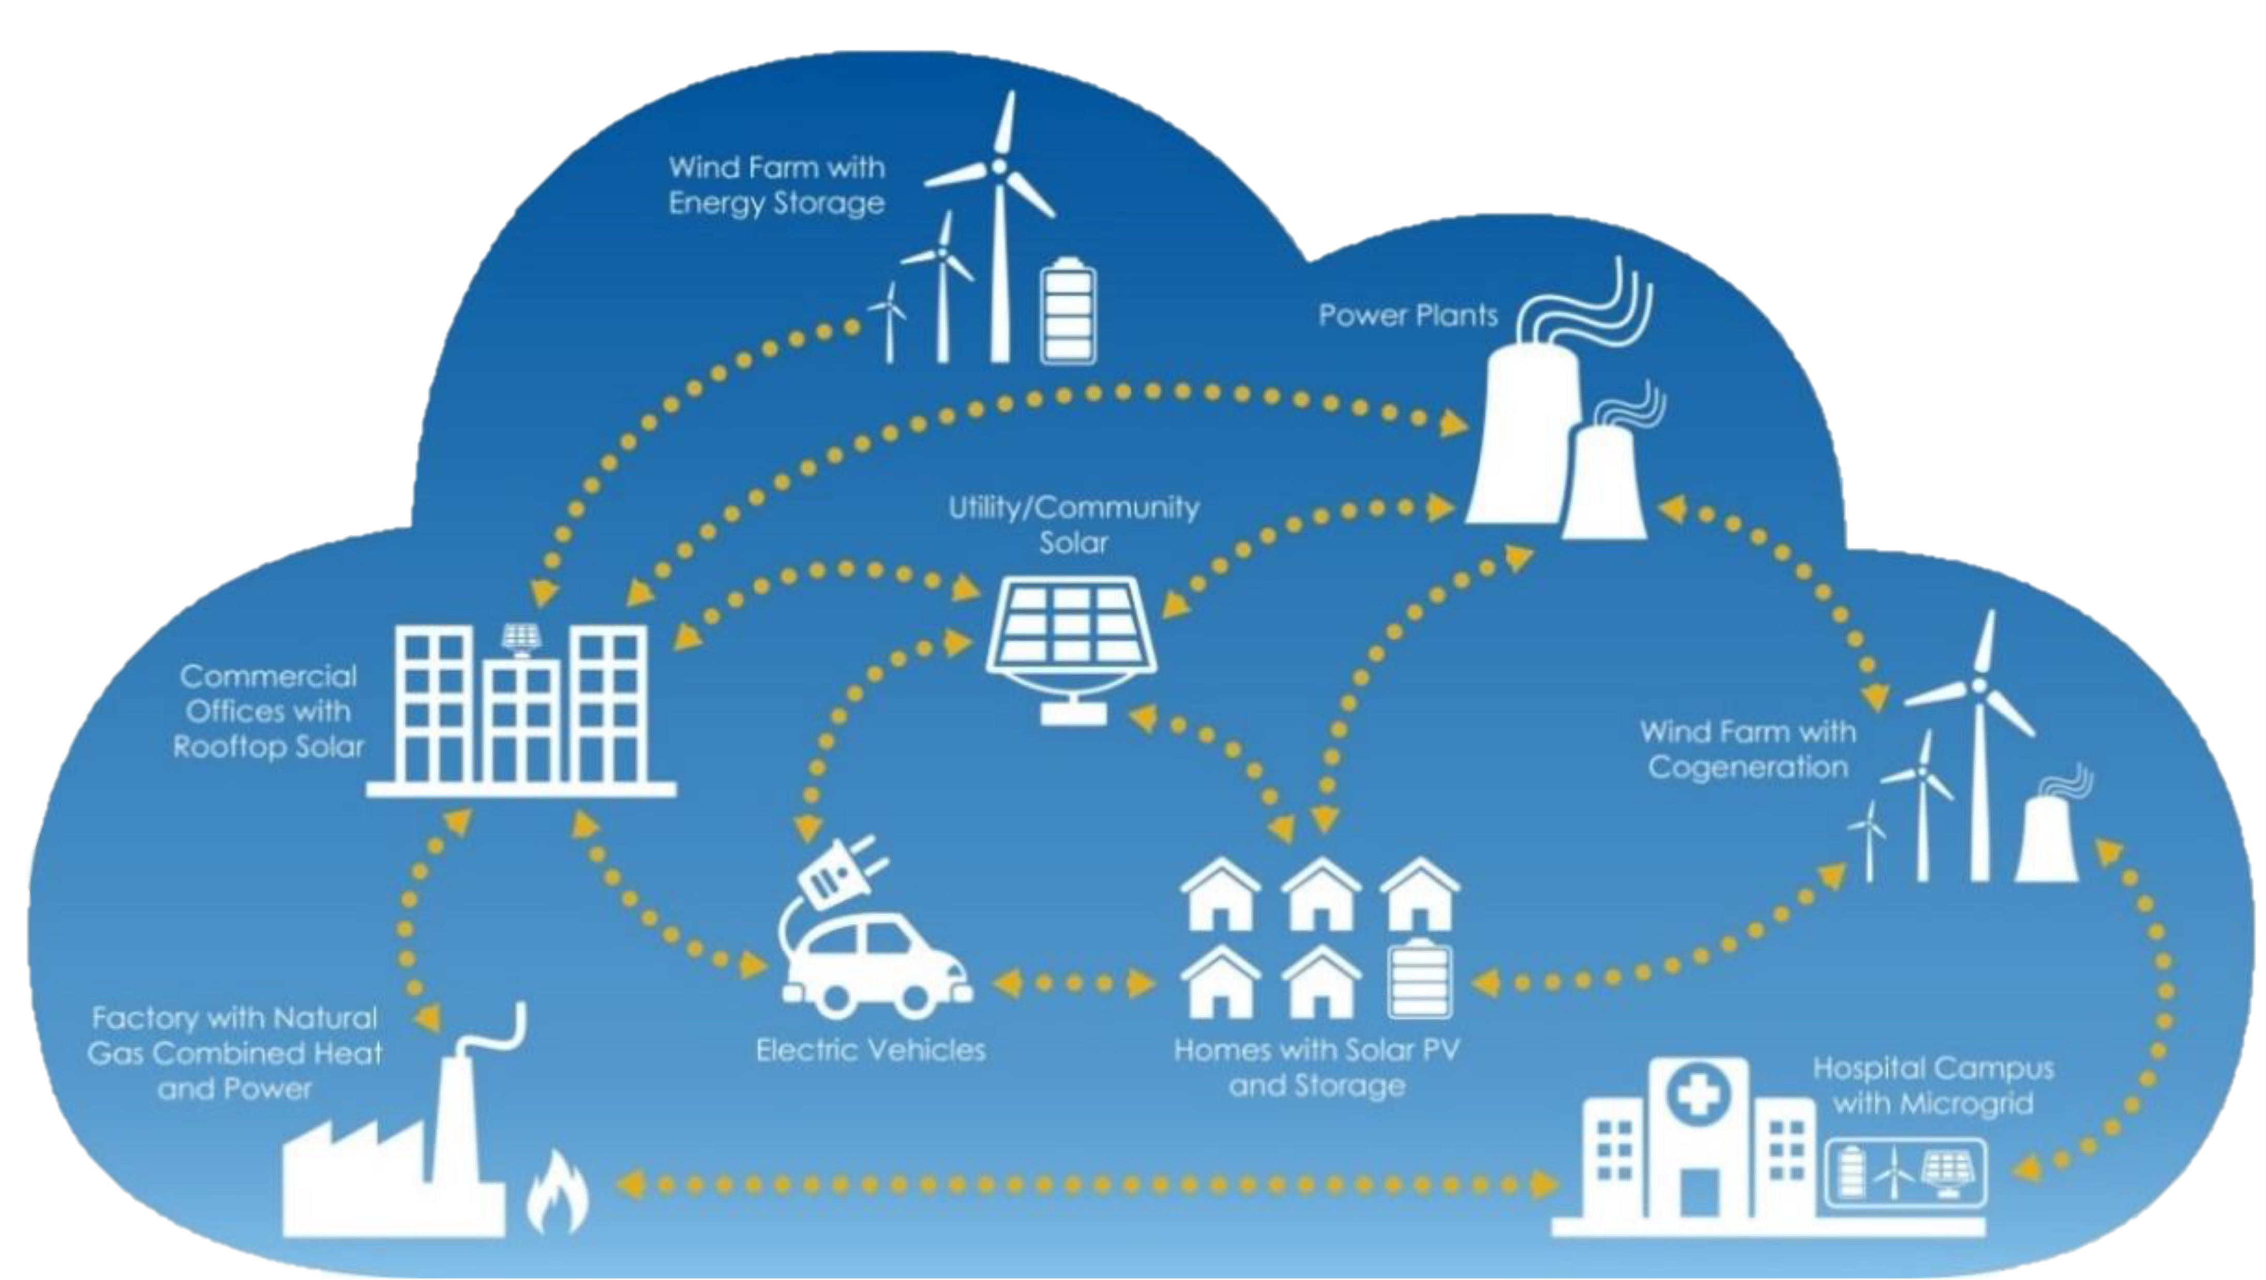
Applications of cloud computing for power systems

Slide 3
Contents
Introduction
Types of cloud computing
Cloud service models
Cloud based power systems programming architecture
Energy monitoring system
Cloud based SCADA configuration
A smart grid with and without cloud
Advantages and Disadvantages
Applications and service providers
Conclusion

Slide 4

Introduction
Cloud computing

Slide 5
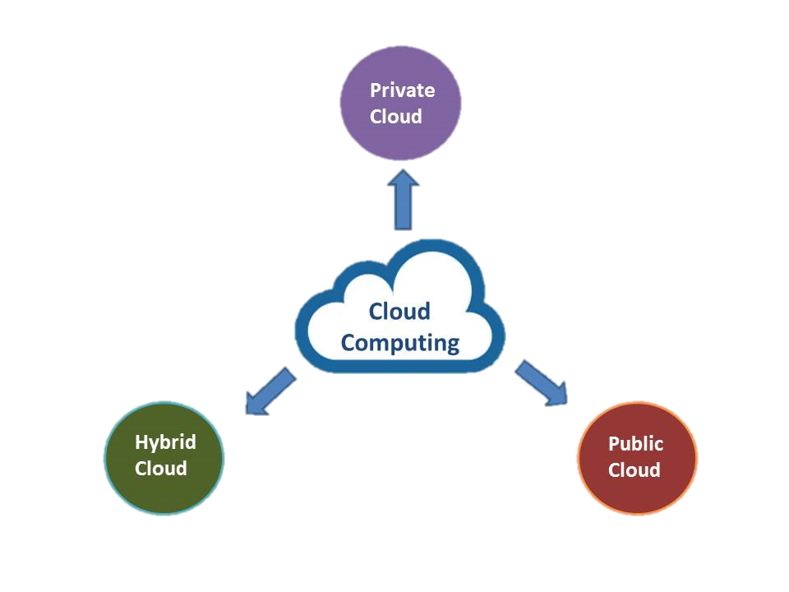
Types of cloud computing

Slide 6
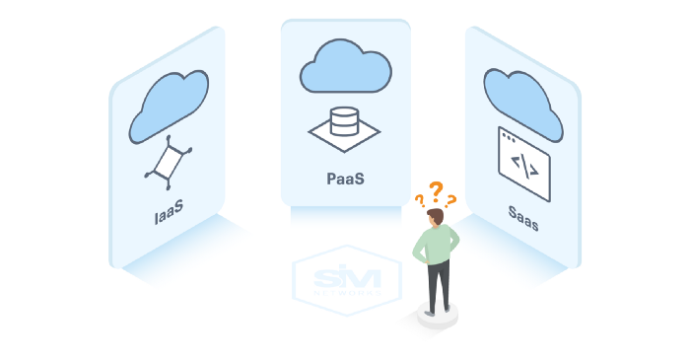
Cloud service models

Slide 7
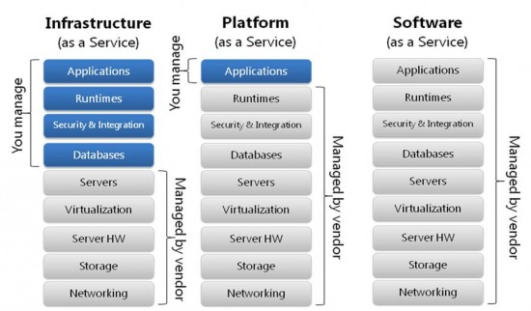

Slide 8
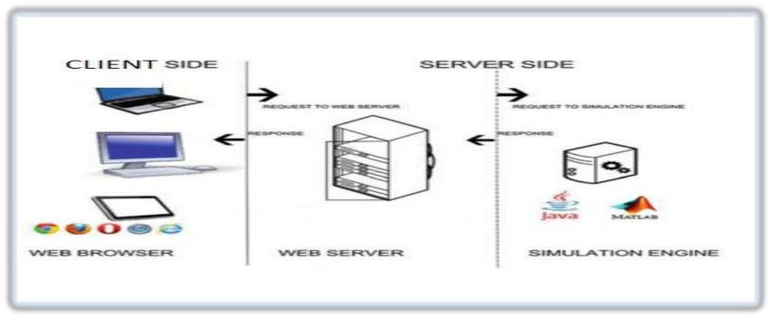
Cloud based power systems programming architecture

Slide 10

Energy monitoring system
Digital Power
Meter
GSM Communication
Gateway
Private Cloud

Slide 11
This system developed to optimize energy usage, to achieve continuous storage and procession of even more than ten millions smart meter’s data, as well as serving millions of users.
The high safety-storage of such amount of data and the large availability of service for number of users can optimally be ensured by the computing power and data storage capability of cloud technologies.

Slide 12
Cloud based SCADA configuration
Data flow

Slide 13
web-based monitoring and controlling application layer is an application layer to visualize, monitor and control the readings of different sensors installed across the network and send control signal to the actuators when it is necessary.
The middle layer is a cloud computing platform which provides server, database system, different operating systems and computing tools.
The lower layer is the smart grid where the actual grid data is collected.

Slide 14
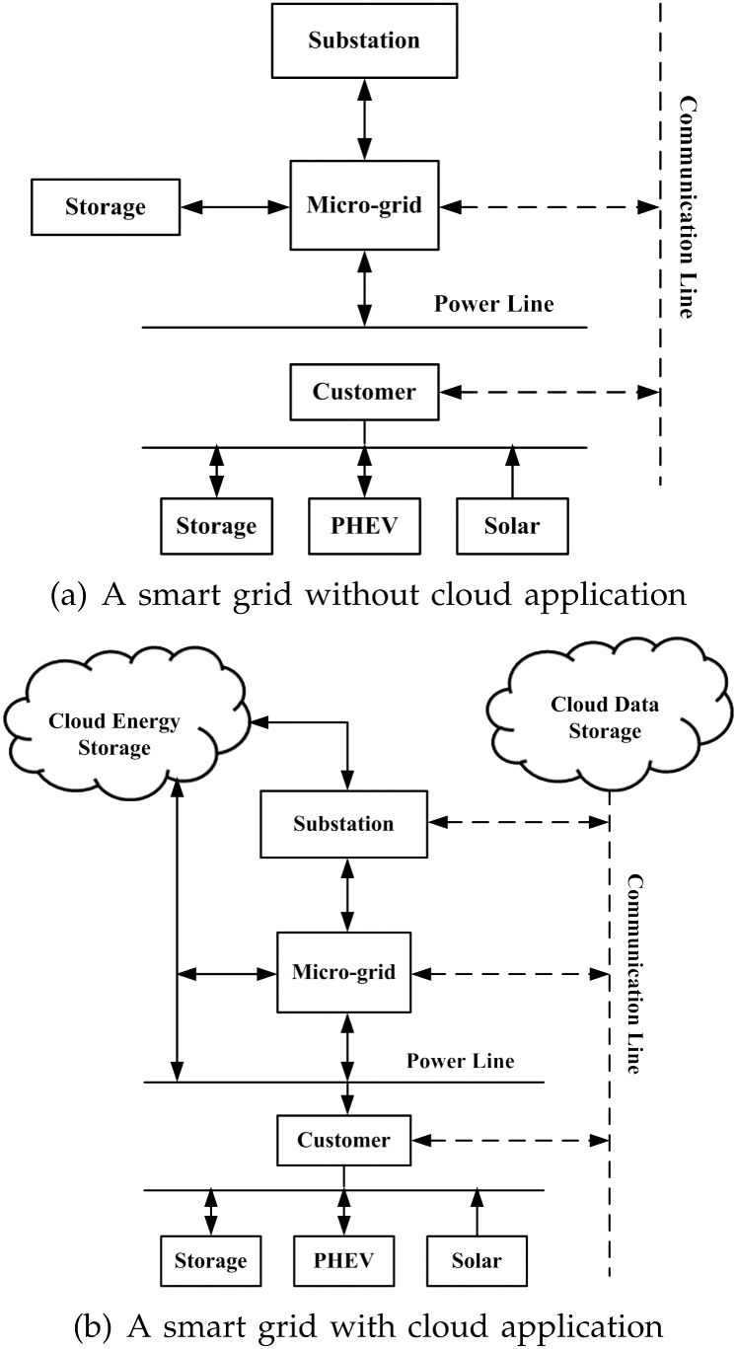
A smart grid without cloud application

Slide 15
A smart grid with cloud

Slide 16
Advantages
Back-up and restore data
Improved collaboration
Excellent accessibility
Low maintenance cost
Mobility
Services in pay-per-use
Unlimited storage capacity
Data security
Device independence

Slide 17
Disadvantages
Internet connectivity
Vendor lock-in
Limited control
Security
Vendor dependence for data maintenance

Slide 18
Applications
Art
Business
Data Storage and Backup
Education
Entertainment
Management
Social

Slide 19
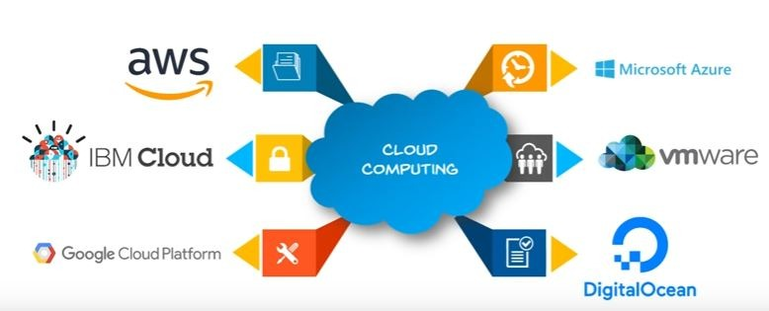
Cloud computing service providers

Slide 20
Conclusion
Thus cloud computing provide a super-computing power
This cloud of computers extends beyond a single company or enterprise.
This applications and data served by the cloud are available to broad group of users, cross-enterprise and cross platform.

Slide 21
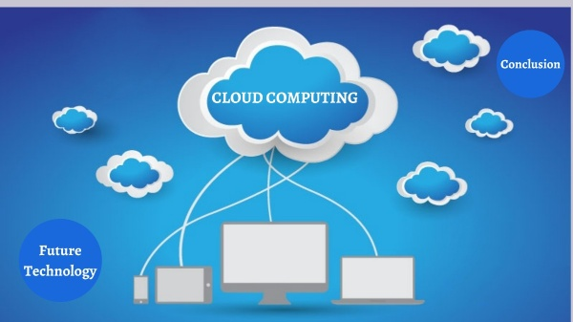
Continued…

Slide 22
References
Peter Mell and Timothy Grace “The NIST Definition of Cloud Computing” NIST Special publication.
V S K Murthy Balijepalli and S A Khaparde “Smart Grid Standards Conformed Cloud Based Demand Side Management Tools” International Journal of Engineering Research & Technology (IJERT), Indian Institute of Technology Bombay.
R.Al-Khannak,“Conceptual Development of Redundant Power System Philosophy by Grid Computing” the research in collaboration between Bolton University and South Westphalia University of Applied Sciences.
Xi Fang, Satyajayant Misra, Guoliang Xue and Dejun Yang “Managing Smart Grid Information in the Cloud: Opportunities, Model, and Applications”, Arizona State University.
Thanyachanok Kleesuwan, “Cloud Computing for monitoring and controlling of distributed energy generations”, Master thesis, South Westphalia University of Applied Sciences, 2014.

Slide 23

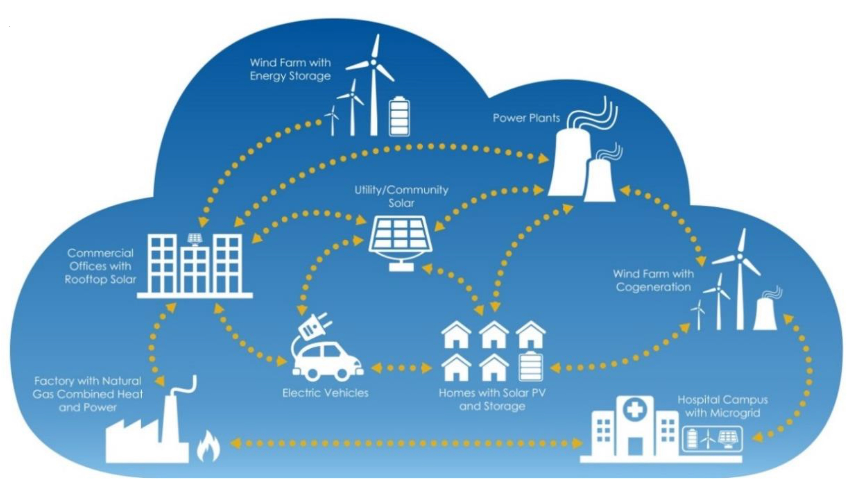

Slide 24


